Slide 1

Introductory Statistics
Introductory Statistics

Slide 2
Outline of the Presentation
Review Finding area or probability within Normal Distributions
Review Mean, Standard Deviation, and Shape of a Distribution of Sample Means, when the parent population is normally distributed
Finding area or probability within a Distribution of Sample means when population data is normally distributed
Review Mean, Standard Deviation, and Shape of a Distribution of Sample Means, when the parent population is NOT normally distributed
Finding area or probability within a Distribution of Sample means when population data is NOT normally distributed

Slide 3
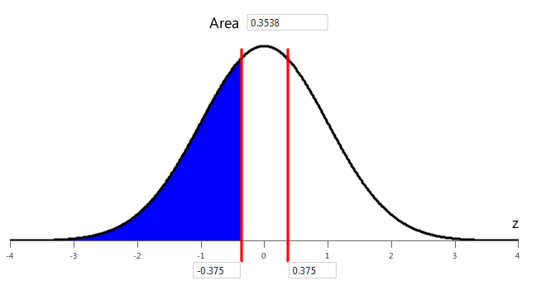
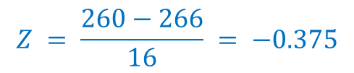
Steps to Finding Area or Probability Under Normal Curve
The length of human pregnancies from conception to birth is normally distributed with mean 266 Days and a standard deviation of 16 days.
What is the probability of a pregnancy lasts less than 260 days?
Convert (standardize) the values of X using the standard normal variable Z (Find the Z-Score)
Find the area under the standard normal curve (Using the applet)
$$Z = \frac{260−266}{16} = −0.375$$
0.3538

Slide 4
Outline of the Presentation
Review Finding area or probability within Normal Distributions
Review Mean, Standard Deviation, and Shape of a Distribution of Sample Means, when the parent population is normally distributed
Finding area or probability within a Distribution of Sample means when population data is normally distributed
Review Mean, Standard Deviation, and Shape of a Distribution of Sample Means, when the parent population is NOT normally distributed
Finding area or probability within a Distribution of Sample means when population data is NOT normally distributed

Slide 5
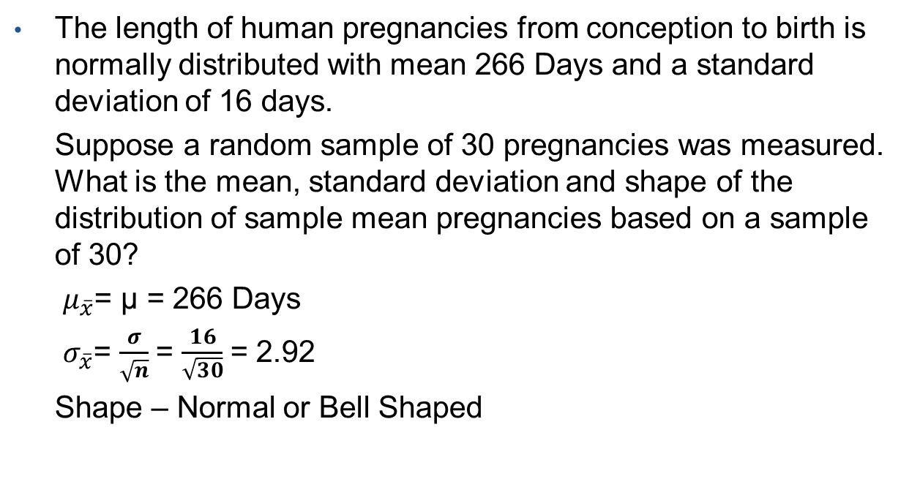
Distribution of Sample Means when Parent Population is Normally Distributed
The length of human pregnancies from conception to birth is normally distributed with mean 266 Days and a standard deviation of 16 days.
Suppose a random sample of 30 pregnancies was measured. What is the mean, standard deviation and shape of the distribution of sample mean pregnancies based on a sample of 30?
$μ_{\overline{x}}$= μ = 266 Days
$σ_{\overline{x}}$= $\frac{σ}{\sqrt{n}}$= $\frac{16}{\sqrt{30}}$= 2.92
Shape – Normal or Bell Shaped

Slide 6
Outline of the Presentation
Review Finding area or probability within Normal Distributions
Review Mean, Standard Deviation, and Shape of a Distribution of Sample Means, when the parent population is normally distributed
Finding area or probability within a Distribution of Sample means when population data is normally distributed
Review Mean, Standard Deviation, and Shape of a Distribution of Sample Means, when the parent population is NOT normally distributed
Finding area or probability within a Distribution of Sample means when population data is NOT normally distributed

Slide 7
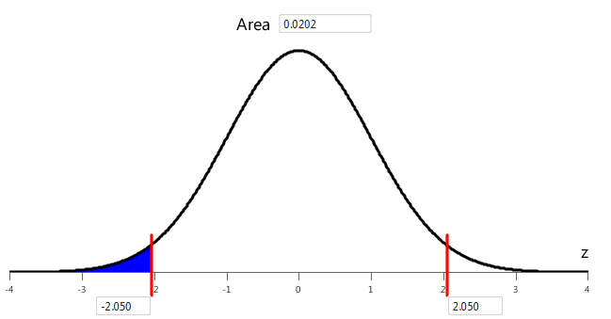
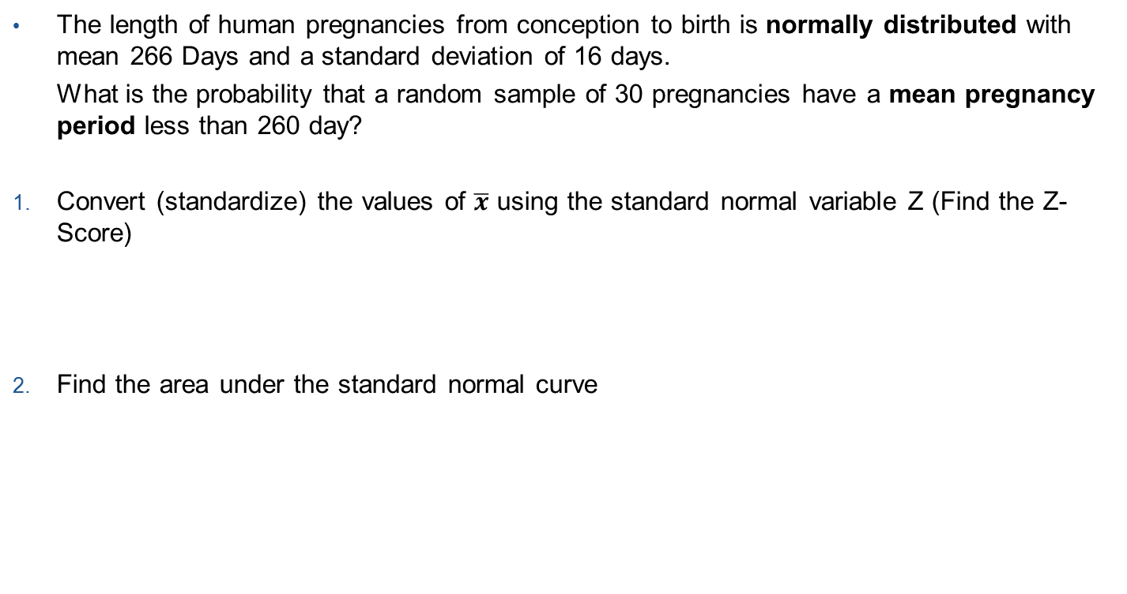
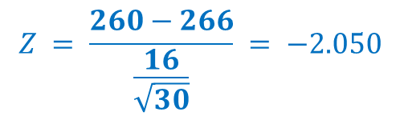
Steps to Finding Area or Probability for a Distribution of Sample Mean
The length of human pregnancies from conception to birth is normally distributed with mean 266 Days and a standard deviation of 16 days.
What is the probability that a random sample of 30 pregnancies have a mean pregnancy period less than 260 day?
Convert (standardize) the values of $\overline{x}$ using the standard normal variable Z (Find the Z-Score)
Find the area under the standard normal curve
$$Z = \frac{260−266}{\frac{16}{\sqrt{30}}} = −2.050$$
0.0202

Slide 8
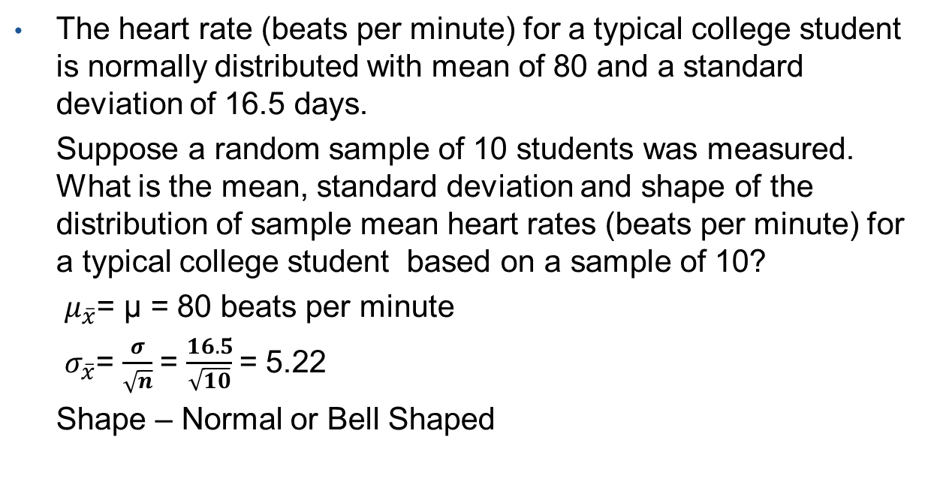
Distribution of Sample Means when Parent Population is Normally Distributed
The heart rate (beats per minute) for a typical college student is normally distributed with mean of 80 and a standard deviation of 16.5 days.
Suppose a random sample of 10 students was measured. What is the mean, standard deviation and shape of the distribution of sample mean heart rates (beats per minute) for a typical college student based on a sample of 10?
$μ_{\overline{x}}$= μ = 80 beats per minute
$σ_{\overline{x}}$= $\frac{σ}{\sqrt{n}}$= $\frac{16.5}{\sqrt{10}}$= 5.22
Shape – Normal or Bell Shaped

Slide 9
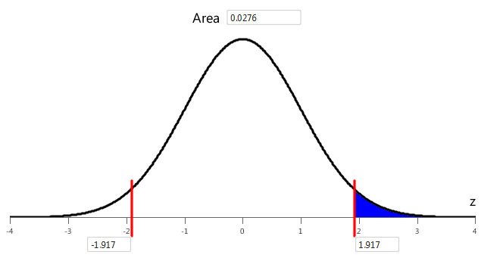
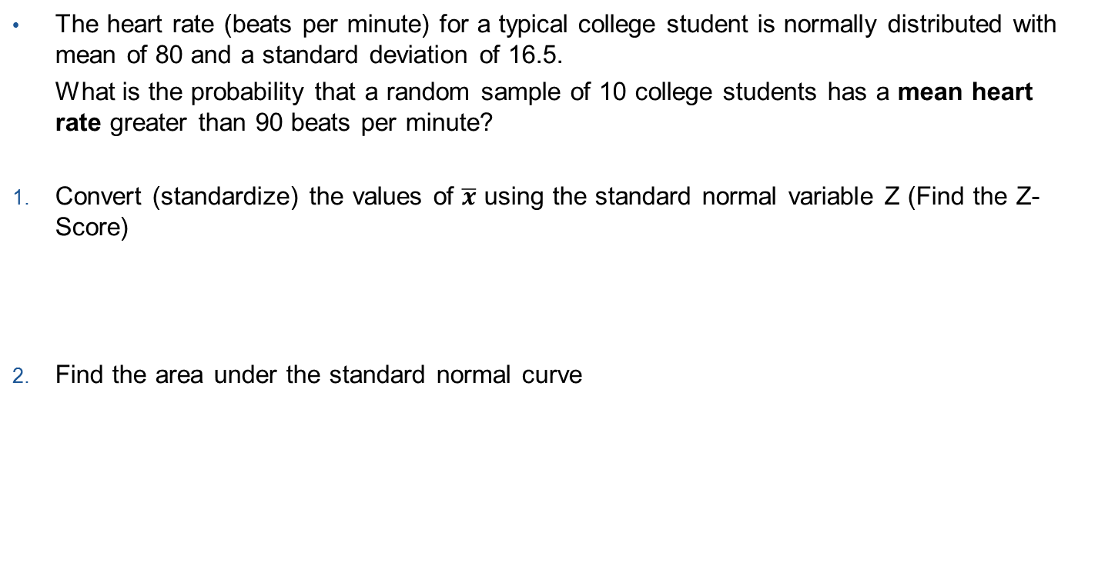

Steps to Finding Area or Probability for a Distribution of Sample Mean
The heart rate (beats per minute) for a typical college student is normally distributed with mean of 80 and a standard deviation of 16.5.
What is the probability that a random sample of 10 college students has a mean heart rate greater than 90 beats per minute?
Convert (standardize) the values of $\overline{x}$ using the standard normal variable Z (Find the Z-Score)
Find the area under the standard normal curve
$$Z = \frac{90−80}{\frac{16.5}{\sqrt{10}}} =1.917$$
0.0276

Slide 10
Outline of the Presentation
Review Finding area or probability within Normal Distributions
Review Mean, Standard Deviation, and Shape of a Distribution of Sample Means, when the parent population is normally distributed
Finding area or probability within a Distribution of Sample means when population data is normally distributed
Review Mean, Standard Deviation, and Shape of a Distribution of Sample Means, when the parent population is NOT normally distributed
Finding area or probability within a Distribution of Sample means when population data is NOT normally distributed

Slide 11
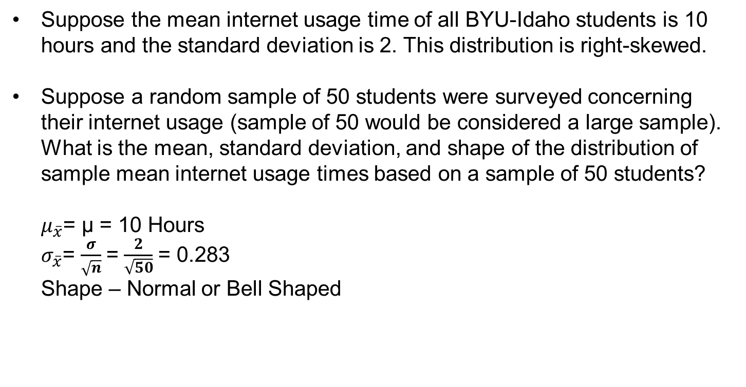
Distribution of Sample Means when Parent Population is NOT Normally Distributed
Suppose the mean internet usage time of all BYU-Idaho students is 10 hours and the standard deviation is 2. This distribution is right-skewed.
Suppose a random sample of 50 students were surveyed concerning their internet usage (sample of 50 would be considered a large sample). What is the mean, standard deviation, and shape of the distribution of sample mean internet usage times based on a sample of 50 students?
$μ_{\overline{x}}$= μ = 10 Hours
$σ_{\overline{x}}$= $\frac{σ}{\sqrt{n}}$= $\frac{2}{\sqrt{50}}$= 0.283
Shape – Normal or Bell Shaped

Slide 12
Outline of the Presentation
Review Finding area or probability within Normal Distributions
Review Mean, Standard Deviation, and Shape of a Sampling Distribution, when the population data is normally distributed
Finding area or probability within a Sampling Distribution when population data is normally distributed
Review Mean, Standard Deviation, and Shape of a Sampling Distribution, when the population data is NOT normally distributed
Finding area or probability within a Sampling Distribution when population data is NOT normally distributed

Slide 13
Outline of the Presentation
Review Finding area or probability within Normal Distributions
Review Mean, Standard Deviation, and Shape of a Distribution of Sample Means, when the parent population is normally distributed
Finding area or probability within a Distribution of Sample means when population data is normally distributed
Review Mean, Standard Deviation, and Shape of a Distribution of Sample Means, when the parent population is NOT normally distributed
Finding area or probability within a Distribution of Sample means when population data is NOT normally distributed

Slide 14
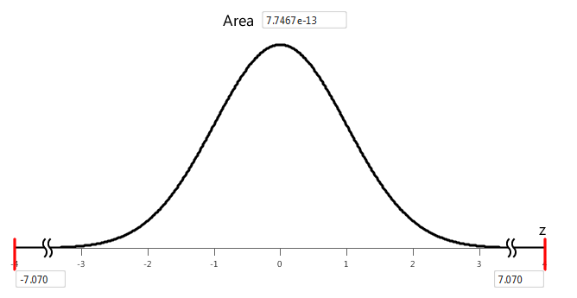


Steps to Finding Area or Probability for a Distribution of Sample Mean
Suppose the mean internet usage time of all BYU-Idaho students is 10 hours and the standard deviation is 2. This distribution is right-skewed.
What is the probability that a random sample of 50 students has a mean internet usage time greater than 12 hours?
Convert (standardize) the values of $\overline{x}$using the standard normal variable Z (Find the Z-Score)
Find the area under the standard normal curve
$$Z=\frac{12−10}{\frac{2}{\sqrt{50}}}=7.07$$
Close to 0.0000.

